Slide 1




MBC 638: Data Analysis & Decision Making
Anna Chernobai
Lecture 07:
Probability (Chapter 4: 4.1-4.2)

Slide 2
What we’ve done so far & what’s next
In previous lectures, we dealt with samples.
In this topic, we’ll be talking about populations.

Slide 3
Today:
What is probability
Uncertainty and probability
Sample space, events & simple events
2. Basic probability rules for relationship between 2 categorical random variables
Joint & disjoint events
Probability of a union of two events (A or B or both)
Joint probability (A and B)
Conditional probability (A|B)
Independent vs. mutually exclusive events
The Bayes formula

Slide 4
1. What is probability
In earlier chapters, we used graphs and numerical measures to describe data sets which were samples. We measured “how often” using
As sample size gets larger:
Relative frequency = f/n
as n  ∞
Sample  Population
f/n  probability

Slide 5
1. What is probability
Some notations:
P(A) = Prob(A) The probability of an event A
P(X=x) = Prob(X=x) The probability that variable X takes a specific value x
The most important rule of probability: 0 ≤ P(A) ≤ 1

Slide 6
1. What is probability
Sample space, events, simple events
Sample space = a set of all basic outcomes (=simple events) in the population.
S = {list of all simple events}
Event = a subset of basic outcomes from the sample space.
An event can consist of simple events.
sample space simple events events

Slide 7
1. What is probability
Example
Example
Experiment: Toss a fair coin once.
Sample space: S = {H,T}
Sample space consists of 2 simple events: H,T.
Simple event example: {T}
Question: What is the prob. of getting T?
Event = {get T}
This event consists of one simple event.
Answer: P(T) = 0.5
Experiment: Toss a fair coin twice.
Sample space: S = {HH,TT,TH,HT}
Sample space consists of 4 simple events.
Simple event examples: {HT}, {TT}
Question: What is the prob. of getting at least one H?
Event = {get at least one H}
This event consists of 3 simple events.
Answer: P(HT or TH or HH) = 1/4+1/4+1/4 = 3/4

Slide 8
1. What is probability
Example
Throw a pair of dice.
There are 36 simple events: (1,1), (1,2), … (6,6), all equally likely.
Event | Simple events | Probability of the event
Dice add to 3 | (1,2),(2,1) | 2/36
Dice add to 6 | (1,5),(2,4),(3,3), (4,2),(5,1) | 5/36
First die shows 1 | (1,1),(1,2),(1,3), (1,4),(1,5),(1,6) | 6/36
Second die shows 1 | (1,1),(2,1),(3,1), (4,1),(5,1),(6,1) | 6/36

Slide 9

Today:
What is probability
Uncertainty and probability
Sample space, events & simple events
Basic probability rules for relationship between 2 categorical random variables
Joint & disjoint events
Probability of a union of two events (A or B or both)
Joint probability (A and B)
Conditional probability (A|B)
Independent vs. mutually exclusive events
The Bayes formula

Slide 10
2. Probability rules
Not disjoint
events
A
B
A&B
Events A and B can occur simultaneously.

Slide 11
2. Probability rules
Examples of events that are not disjoint:
A person has blue eyes (event A) and dark hair (event B)
Throwing die once results in an even number (event A) and a number greater than 3 (event B)
A person has a low exam score (event A) and never drinks (event B)

Slide 12
2. Probability rules
Not disjoint
events
Disjoint (mutually exclusive)
events
A
A
B
B
A&B
Events A and B can occur simultaneously.
.

Slide 13
2. Probability rules
Examples of events that are not disjoint:
A person has blue eyes (event A) and dark hair (event B)
Throwing die once results in an even number (event A) and a number greater than 3 (event B)
A person has a low exam score (event A) and never drinks (event B)
Examples of events that are disjoint (= mutually exclusive):
Company’s revenue is under $1 mln (event A) and above $2 mln (event B) at the same time
H. Clinton becomes the President (event A) and D. Trump becomes the President (event B) at the same time
Sujay dates Tamara (event A) and dates Zartaj (event B) at the same time 

Slide 14
2. Probability rules
The following notations are used interchangeably:
Complement A^{C} = A = A’ = not A
Joint A B = A and B
Union A U B = A or B or both
Condition A | B = A given B = A occurs if B occurs
U

Slide 15
2. Probability rules
Complement:
P(A^{C})= P(not A)=1-P(A)
P(A) + P(A^{c}) = 1
Joint:
P(A and B) = P(A B)
Union:
P(AUB) = P(A or B or both)
= P(A) + P(B) - P(A B)
Conditional:
P(A|B) = P(A B) / P(B) /
P(B|A) = P(A B) / P(A) /
A
A
A & B
B
S
A
U
B
A
B
U
U
U

Slide 16
2. Probability rules
Complement:
P(A^{C})= P(not A)=1-P(A)
P(A) + P(A^{c}) = 1
Joint:
P(A and B) = P(A B)
Union:
P(AUB) = P(A or B or both)
= P(A) + P(B) - P(A B)
Conditional:
P(A|B) = P(A B) / P(B) /
P(B|A) = P(A B) / P(A) /
A
A
A & B
B
S
A
U
B
A
B
U
U
U

Slide 17
2. Probability rules
Complement:
P(A^{C})= P(not A)=1-P(A)
P(A) + P(A^{c}) = 1
Joint:
P(A and B) = P(A B)
Union:
P(AUB) = P(A or B or both)
= P(A) + P(B) - P(A B)
Conditional:
P(A|B) = P(A B) / P(B) /
P(B|A) = P(A B) / P(A) /
A
A
A & B
B
S
A
U
B
A
B
U
U
U

Slide 18
2. Probability rules
Complement:
P(A^{C})= P(not A)=1-P(A)
P(A) + P(A^{c}) = 1
Joint:
P(A and B) = P(A B)
Union:
P(AUB) = P(A or B or both)
= P(A) + P(B) - P(A B)
Conditional:
P(A|B) = P(A B) / P(B) /
P(B|A) = P(A B) / P(A) /
A
A
A & B
B
S
A
U
B
A
B
U
U
B
U
A

Slide 19
2. Probability rules
Some useful variations of the same rules:
P(A or B but not both)=P(A)+P(B)-2·P(A and B)
P(A only)=P(A)-P(A and B)
P(B only)=P(B)-P(A and B)
P(Neither A nor B)=1-P(A or B or both)
P(A and B)=P(A|B)·P(B)
=P(B|A)·P(A)
A
B
A
B
A
B

Slide 20
2. Probability rules
Joint probability table:
 | A | A^{c}
B | P(A and B) | P(B and A^{c}) | P(B)
B^{c} | P(B^{c} and A) | P(A^{c} and B^{c}) | P(B^{c})
 | P(A) | P(A^{c}) | 1

Slide 21
2. Probability rules
Example
Event T = Boyce dates Tamara next spring
Event H = Boyce is happy next spring
 | Boyce dates Tamara | Boyce doesn’t date Tamara
Boyce is happy | 0.5 | 0.1 | 0.6
Boyce isn’t happy | 0.05 | 0.35 | 0.4
 | 0.55 | 0.45 | 1

Slide 22
2. Probability rules
Example
Event T = Boyce dates Tamara next spring
Event H = Boyce is happy next spring
 | Boyce dates Tamara | Boyce doesn’t date Tamara
Boyce is happy | 0.5 | 0.1 | 0.6
Boyce isn’t happy | 0.05 | 0.35 | 0.4
 | 0.55 | 0.45 | 1
What is the probability that Boyce dates Tamara?
P(T and H) = 0.55

Slide 23
2. Probability rules
Example
Event T = Boyce dates Tamara next spring
Event H = Boyce is happy next spring
 | Boyce dates Tamara | Boyce doesn’t date Tamara
Boyce is happy | 0.5 | 0.1 | 0.6
Boyce isn’t happy | 0.05 | 0.35 | 0.4
 | 0.55 | 0.45 | 1
What is the probability that Boyce dates Tamara and is happy?
P(T and H) = 0.5

Slide 24
2. Probability rules
Example
Event T = Boyce dates Tamara next spring
Event H = Boyce is happy next spring
 | Boyce dates Tamara | Boyce doesn’t date Tamara
Boyce is happy | 0.5 | 0.1 | 0.6
Boyce isn’t happy | 0.05 | 0.35 | 0.4
 | 0.55 | 0.45 | 1
What is the probability that Boyce doesn’t date Tamara and is happy?
P(T and H^{C} ) = 0.1

Slide 25
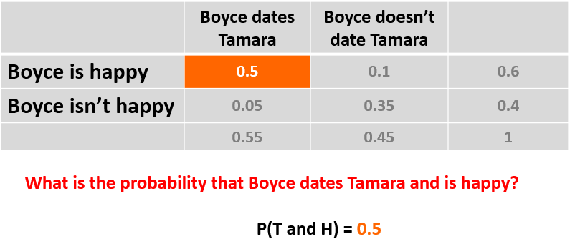
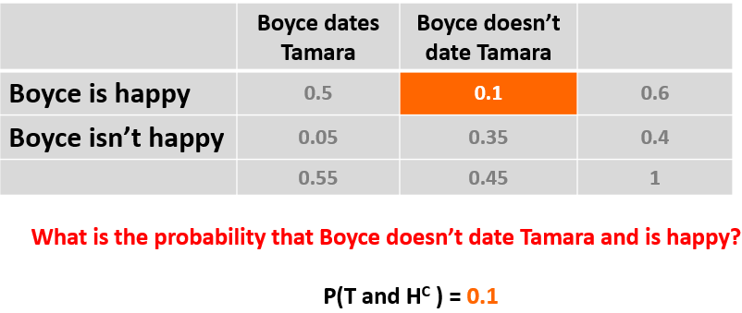
2. Probability rules
Notice:
The two probabilities add up to P(H).
P(H&T)+P(H&T^{C})=0.6

Slide 26
2. Probability rules
Example
Event T = Boyce dates Tamara next spring
Event H = Boyce is happy next spring
 | Boyce dates Tamara | Boyce doesn’t date Tamara
Boyce is happy | 0.5 | 0.1 | 0.6
Boyce isn’t happy | 0.05 | 0.35 | 0.4
 | 0.55 | 0.45 | 1
If Boyce dates Tamara, what’s the probability he is happy?
P(H | T) = P(H & T) / P(T) = 0.5 / 0.55 = 0.91 (or 91%)

Slide 27
2. Probability rules
Example
Event T = Boyce dates Tamara next spring
Event H = Boyce is happy next spring
 | Boyce dates Tamara | Boyce doesn’t date Tamara
Boyce is happy | 0.5 | 0.1 | 0.6
Boyce isn’t happy | 0.05 | 0.35 | 0.4
 | 0.55 | 0.45 | 1
If Boyce dates Tamara, what’s the probability he is NOT happy?
P(H^{C} | T) = P(H^{C} & T) / P(T) = 0.05 / 0.55 = 0.09 (or 9%)

Slide 28
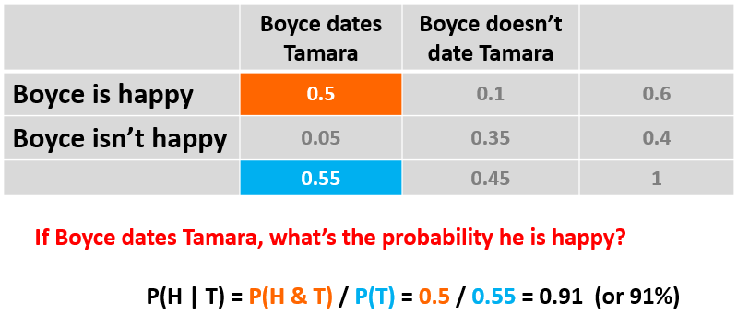
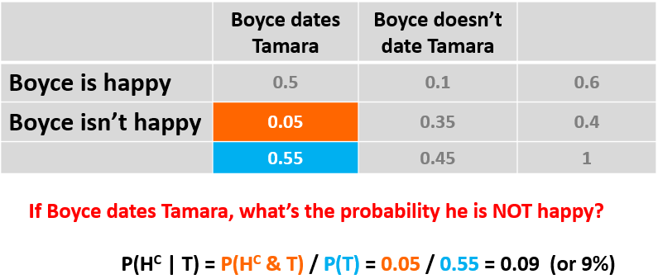
2. Probability rules
Notice:
The two probabilities add up to 1.
P(H|T)+P(H^{C}|T)=1

Slide 29
2. Probability rules
Example
Event T = Boyce dates Tamara next spring
Event H = Boyce is happy next spring
 | Boyce dates Tamara | Boyce doesn’t date Tamara
Boyce is happy | 0.5 | 0.1 | 0.6
Boyce isn’t happy | 0.05 | 0.35 | 0.4
 | 0.55 | 0.45 | 1
If Boyce is happy, what’s the probability he is dating Tamara?
P(T | H) = P(H & T) / P(H) = 0.5 / 0.6 = 0.83 (or 83%)

Slide 30
2. Probability rules
Example
Event T = Boyce dates Tamara next spring
Event H = Boyce is happy next spring
 | Boyce dates Tamara | Boyce doesn’t date Tamara
Boyce is happy | 0.5 | 0.1 | 0.6
Boyce isn’t happy | 0.05 | 0.35 | 0.4
 | 0.55 | 0.45 | 1
If Boyce is happy, what’s the probability he is NOT dating Tamara?
P(T^{C} | H) = P(H & T^{C} ) / P(H) = 0.1 / 0.6 = 0.17 (or 17%)
Or: P(T^{C} | H) = 1 - P(T | H) = 2 – 0.83 = 0.17

Slide 31
2. Probability rules
Example
Event T = Boyce dates Tamara next spring
Event H = Boyce is happy next spring
 | Boyce dates Tamara | Boyce doesn’t date Tamara
Boyce is happy | 0.5 | 0.1 | 0.6
Boyce isn’t happy | 0.05 | 0.35 | 0.4
 | 0.55 | 0.45 | 1
If Boyce is NOT happy, what’s the probability he is NOT dating Tamara?
P(T^{C} | H^{C} ) = P(H^{C} & T^{C} ) / P(H^{C} ) = 0.35 / 0.4 = 0.875 (or 87.5%)

Slide 32
2. Probability rules
Independent events
Events A and B are independent if P(A|B)=P(A) and P(B|A)=P(B)
If objects are “randomly selected”, it means they are independent.
Are two events independent? Can check mathematically the formula above.
If events A and B are independent, then P(A and B) = P(A) · P(B)
If events A and B are independent, then cov(A,B) = 0
(But not necessarily vice versa – remember from the last topic?)
Recall: If A and B are disjoint, then P(A and B) = 0

Slide 33
2. Probability rules
Example
In a certain population, 10% of the people can be classified as being high risk for a heart attack. We know also that only 49% of the population are female. Also, of the female patients, 8% are high risk.
A single person is selected at random.
What is the probability that it is a high risk female?

Slide 34
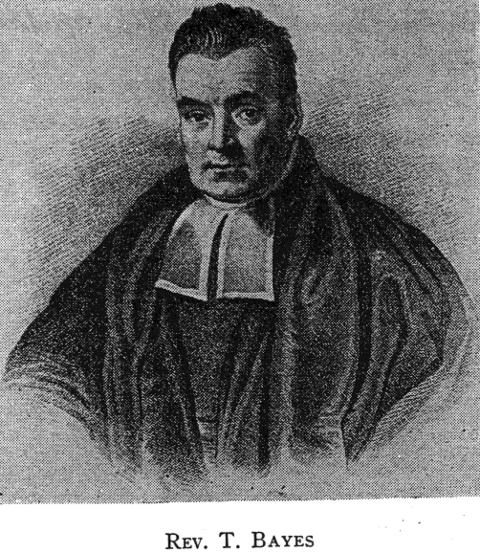
2. Probability rules
The Bayes formula

Slide 35
2. Probability rules
Understanding the denominator in the Bayes formula
A
A^{C}
Sample space (S)
A and B
A^{C} and B
Event B
(everything inside the oval is B
everything outside of the oval is B^{C})
P(B) = P(A and B) + P(A^{C} and B)
= P(B|A)·P(A) + P(B|A^{C})·P(A^{C})

Slide 36
2. Probability rules
Application: Finance (banking)
Bank of America reviewed its credit card policy with the intention of recalling some of its credit cards. In the past, approximately 5% of cardholders defaulted (i.e., were unable to pay their outstanding balance), leaving the bank unable to collect the outstanding balance. The bank also found that 20% of customers who do not default end up missing their monthly payment. Of course, if a customer has defaulted, the probability that he misses a monthly payment is one!
Suppose, Bank of America has recorded that one of their customers, Mr. Coleman, has missed one or more monthly payments. What is the probability that he will default?
Under the bank’s new credit card policy, the bank would like to recall its card if the probability that a customer will default is greater than 20%. Should the bank recall its card if Mr. Coleman misses a monthly payment?
Example

Slide 37
2. Probability rules
Example
Application: Accounting
The Dallas IRS auditing staff, concerned with identifying potentially fraudulent tax returns, believes that the probability of finding a fraudulent return given that the return contains deductions for contributions exceeding the IRS standard is 20%. However, given that the deductions for contributions do not exceed the IRS standard, the probability of a fraudulent return decreases to just 2%. In total, 8% of all returns exceed the IRS standard for deductions due to contributions.
What is the best estimate of the percentage of fraudulent returns?
b) What is the probability that, if returns do not contain deductions for contributions exceeding the IRS standard, the return would be found to be not fraudulent?

Slide 38
Today:
What is probability
Uncertainty and probability
Sample space, events & simple events
2. Basic probability rules for relationship between 2 categorical random variables
Joint & disjoint events
Probability of a union of two events (A or B or both)
Joint probability (A and B)
Conditional probability (A|B)
Independent vs. mutually exclusive events
The Bayes formula

Slide 39
EXTRA SLIDES (probability trees)

Slide 40
2. Probability rules
Probability Tree:
A
B
P(A|B)
P(A&B)=P(A|B)P(B)
P(B|A)
P(A&B)=P(B|A)P(A)
B
A
P(B)
P(A^{c}|B)
A^{c}
P(A)
P(B^{c}|A)
B^{c}
P(A^{c}&B)=P(A^{c}|B)P(B)
P(A&B^{c})=P(B^{c}|A)P(A)
A
B
P(B^{c})
P(A|B^{c})
P(A^{c})
P(B|A^{c})
P(A&B^{c})=P(A|B^{c})P(B^{c})
P(A^{c}&B)=P(B|A^{c})P(A^{c})
B^{c}
A^{c}
P(A^{c}|B^{c})
A^{c}
P(B^{c}|A^{c})
B^{c}
P(A^{c}&B^{c})=P(A^{c}|B^{c})P(B^{c})
P(A^{c}&B^{c})=P(B^{c}|A^{c})P(A^{c})

Slide 41
2. Probability rules
CONDITIONAL PROBABILITY
Probability Tree:
A
B
P(A|B)
P(A&B)=P(A|B)P(B)
P(B|A)
P(A&B)=P(B|A)P(A)
B
A
P(B)
P(A^{c}|B)
A^{c}
P(A)
P(B^{c}|A)
B^{c}
P(A^{c}&B)=P(A^{c}|B)P(B)
P(A&B^{c})=P(B^{c}|A)P(A)
A
B
P(B^{c})
P(A|B^{c})
P(A^{c})
P(B|A^{c})
P(A&B^{c})=P(A|B^{c})P(B^{c})
P(A^{c}&B)=P(B|A^{c})P(A^{c})
B^{c}
A^{c}
P(A^{c}|B^{c})
A^{c}
P(B^{c}|A^{c})
B^{c}
P(A^{c}&B^{c})=P(A^{c}|B^{c})P(B^{c})
P(A^{c}&B^{c})=P(B^{c}|A^{c})P(A^{c})

Slide 42
2. Probability rules
CONDITIONAL PROBABILITY
Probability Tree:
A
B
P(A|B)
P(A&B)=P(A|B)P(B)
P(B|A)
P(A&B)=P(B|A)P(A)
B
A
Add up to 1
P(B)
P(A^{c}|B)
A^{c}
P(A)
P(B^{c}|A)
B^{c}
P(A^{c}&B)=P(A^{c}|B)P(B)
P(A&B^{c})=P(B^{c}|A)P(A)
A
B
P(B^{c})
P(A|B^{c})
P(A^{c})
P(B|A^{c})
P(A&B^{c})=P(A|B^{c})P(B^{c})
P(A^{c}&B)=P(B|A^{c})P(A^{c})
Add up to 1
B^{c}
A^{c}
P(A^{c}|B^{c})
A^{c}
P(B^{c}|A^{c})
B^{c}
P(A^{c}&B^{c})=P(A^{c}|B^{c})P(B^{c})
P(A^{c}&B^{c})=P(B^{c}|A^{c})P(A^{c})

Slide 43
2. Probability rules
COMPLEMENTS
Probability Tree:
A
B
P(A|B)
P(A&B)=P(A|B)P(B)
P(B|A)
P(A&B)=P(B|A)P(A)
B
A
Add up to 1
P(B)
P(A^{c}|B)
A^{c}
P(A)
P(B^{c}|A)
B^{c}
P(A^{c}&B)=P(A^{c}|B)P(B)
P(A&B^{c})=P(B^{c}|A)P(A)
Add up to 1
A
B
P(B^{c})
P(A|B^{c})
P(A^{c})
P(B|A^{c})
P(A&B^{c})=P(A|B^{c})P(B^{c})
P(A^{c}&B)=P(B|A^{c})P(A^{c})
B^{c}
A^{c}
P(A^{c}|B^{c})
A^{c}
P(B^{c}|A^{c})
B^{c}
P(A^{c}&B^{c})=P(A^{c}|B^{c})P(B^{c})
P(A^{c}&B^{c})=P(B^{c}|A^{c})P(A^{c})

Slide 44
2. Probability rules
JOINT PROBABILITY
Probability Tree:
A
B
P(A|B)
P(A&B)=P(A|B)P(B)
P(B|A)
P(A&B)=P(B|A)P(A)
B
A
P(B)
P(A^{c}|B)
A^{c}
P(A)
P(B^{c}|A)
B^{c}
P(A^{c}&B)=P(A^{c}|B)P(B)
P(A&B^{c})=P(B^{c}|A)P(A)
A
B
P(B^{c})
P(A|B^{c})
P(A^{c})
P(B|A^{c})
P(A&B^{c})=P(A|B^{c})P(B^{c})
P(A^{c}&B)=P(B|A^{c})P(A^{c})
B^{c}
A^{c}
P(A^{c}|B^{c})
A^{c}
P(B^{c}|A^{c})
B^{c}
P(A^{c}&B^{c})=P(A^{c}|B^{c})P(B^{c})
P(A^{c}&B^{c})=P(B^{c}|A^{c})P(A^{c})

Slide 45
2. Probability rules
JOINT PROBABILITY
Probability Tree:
A
B
P(A|B)
P(A&B)=P(A|B)P(B)
P(B|A)
P(A&B)=P(B|A)P(A)
B
A
Add up to P(B)
Add up to P(A)
P(B)
P(A^{c}|B)
A^{c}
P(A)
P(B^{c}|A)
B^{c}
P(A^{c}&B)=P(A^{c}|B)P(B)
P(A&B^{c})=P(B^{c}|A)P(A)
A
B
P(B^{c})
P(A|B^{c})
P(A^{c})
P(B|A^{c})
P(A&B^{c})=P(A|B^{c})P(B^{c})
P(A^{c}&B)=P(B|A^{c})P(A^{c})
B^{c}
A^{c}
P(A^{c}|B^{c})
A^{c}
P(B^{c}|A^{c})
B^{c}
P(A^{c}&B^{c})=P(A^{c}|B^{c})P(B^{c})
P(A^{c}&B^{c})=P(B^{c}|A^{c})P(A^{c})

